Slide 1
KEA Meeting
By: Lela Bones

Slide 2
Prep for goals

Slide 3
Goals
Create visualization dashboard
  Web-Based Interface
    Flask
  Interactive graphs
    Bokeh
    Holoviews
Generate more data
  Recurrent Neural Nets (RNNs)
  Pytorch

Slide 4
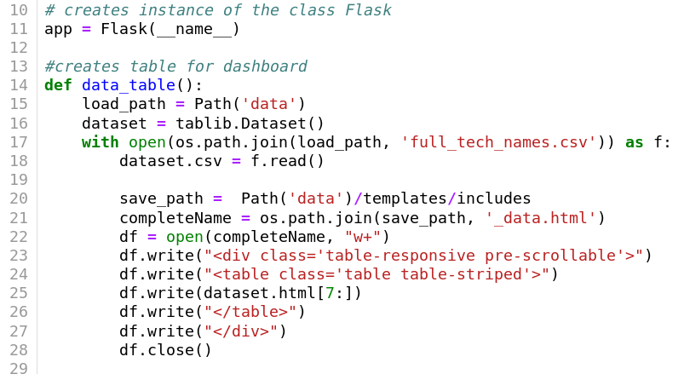
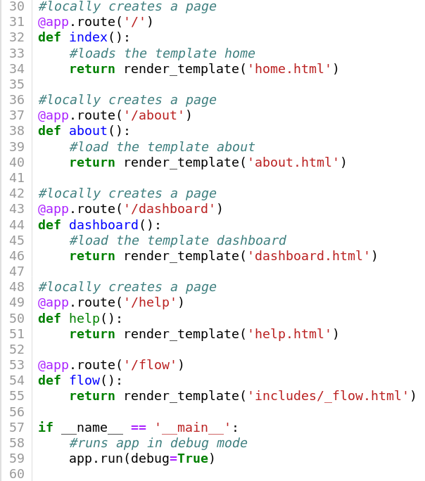
Dashboard Development

Slide 5
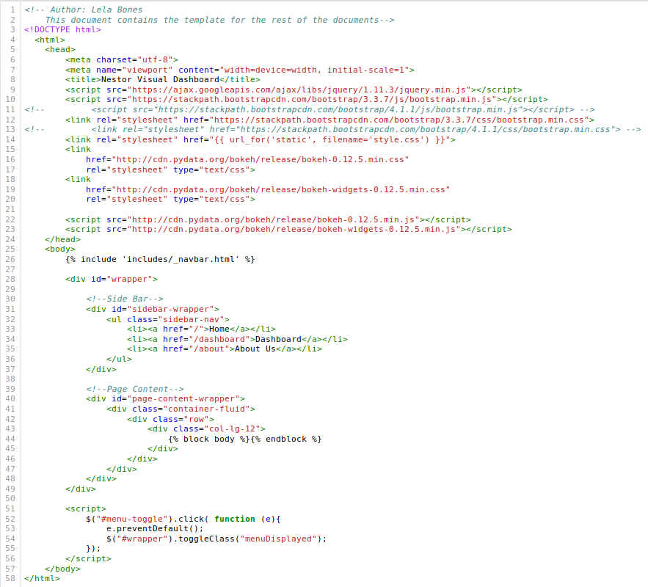
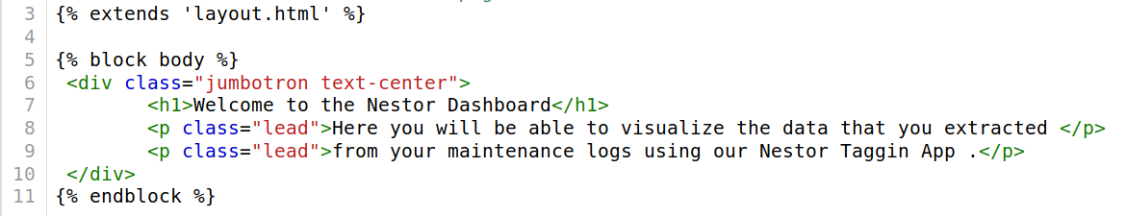
Dashboard Dev Cont...

Slide 6
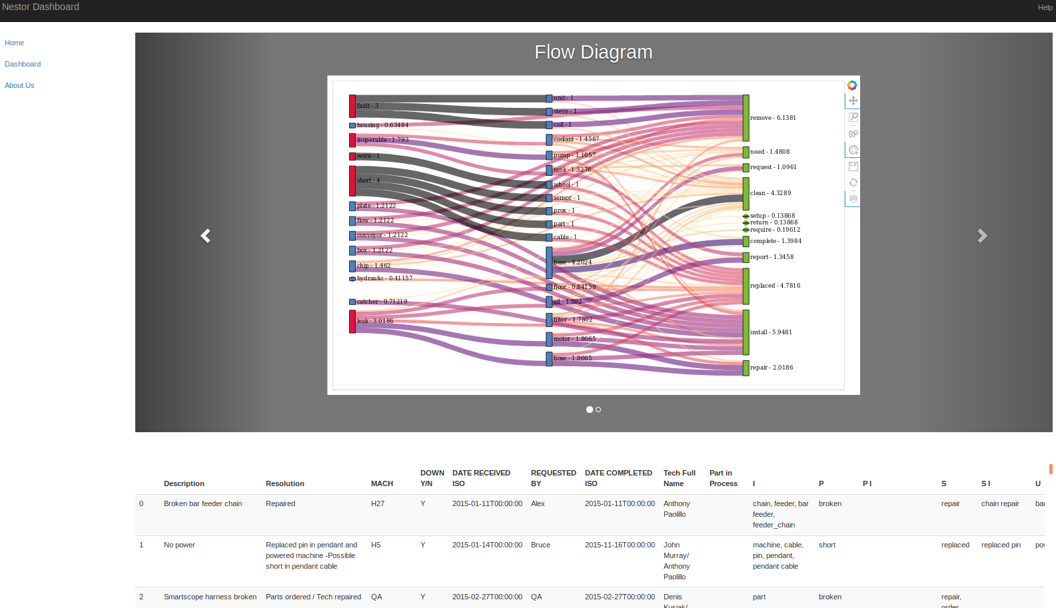
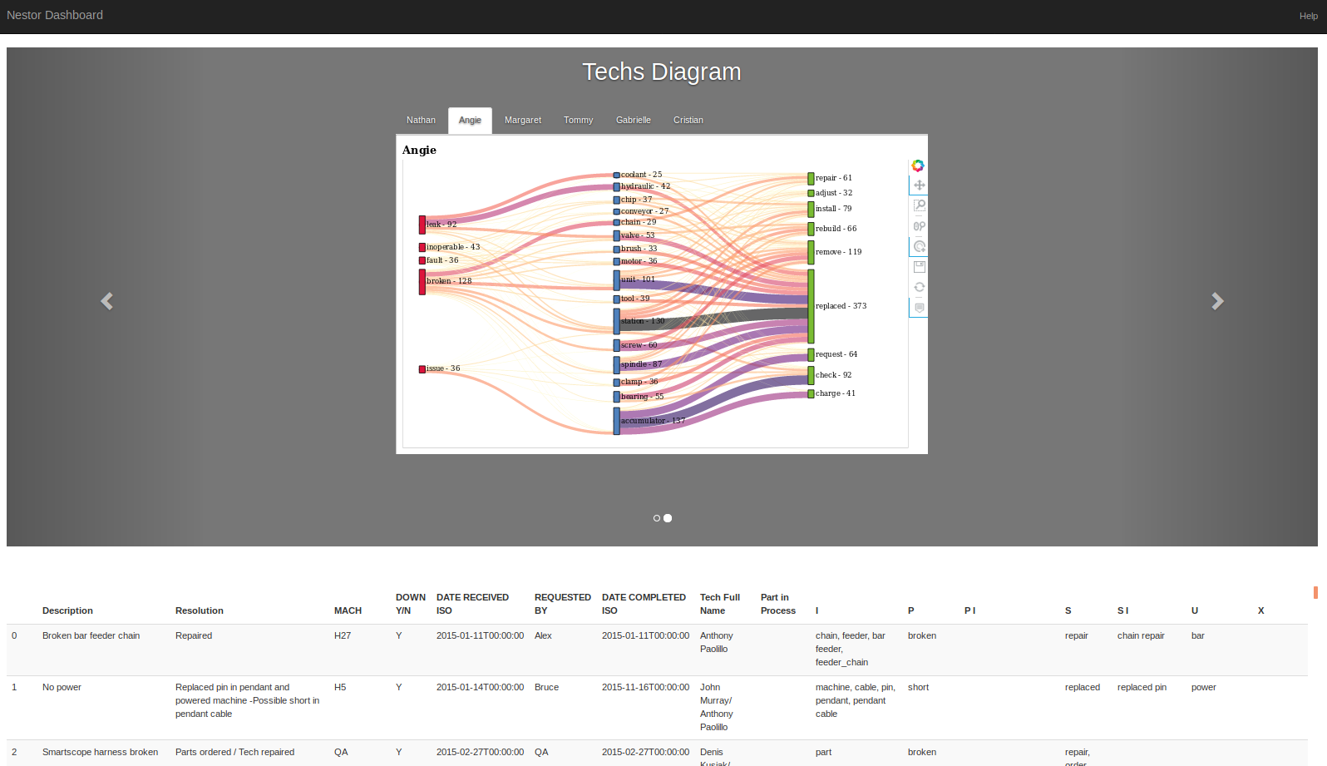
The Dashboard

Slide 7
Pytorch
What is it?
A framework built on top of Torch which creates numpy like arrays
Used most commonly by Facebook
Dynamical deep learning tool
Why choose it?
Native to Python
Customizable
Easy to debug
Works well with Flask
Declarative data parallelism which allows you to use multiple GPUs

